Slide 1
My Home Library Database
Shen Gao

Slide 2
Purpose
Database: record-keeping
Library database
Search for author/book
Borrow/return book
Become member
Donate books

Slide 3
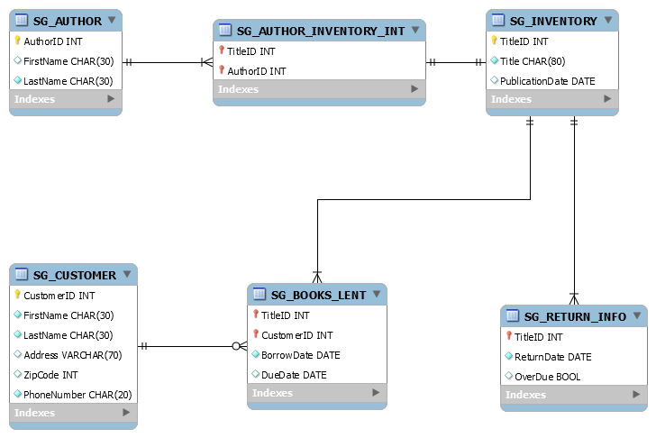
Data Model
Assumptions
Author
Return Info
Customer

Slide 4
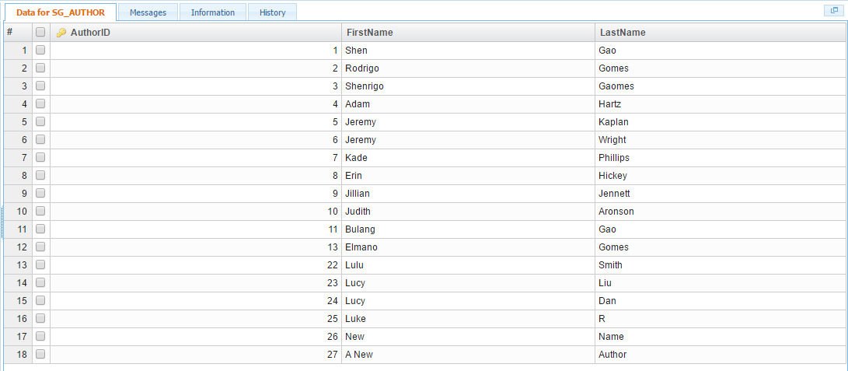
Tables

Slide 5
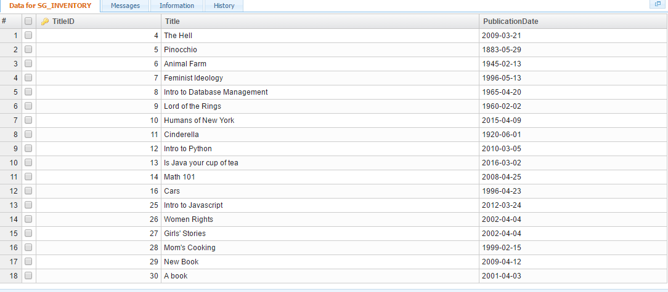

Slide 6
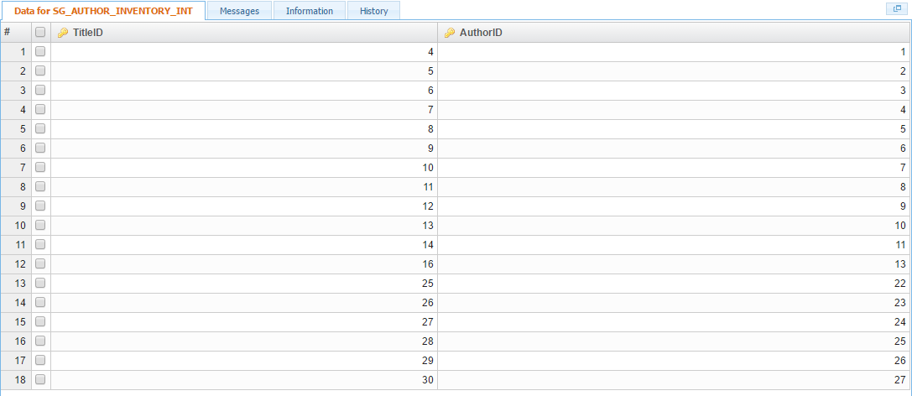

Slide 7
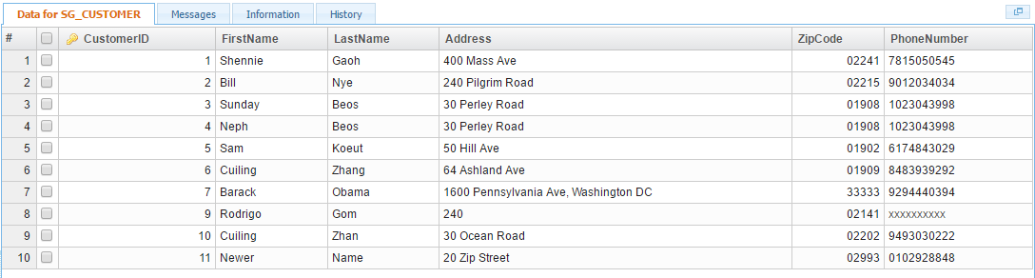

Slide 8
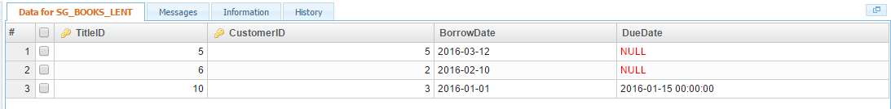
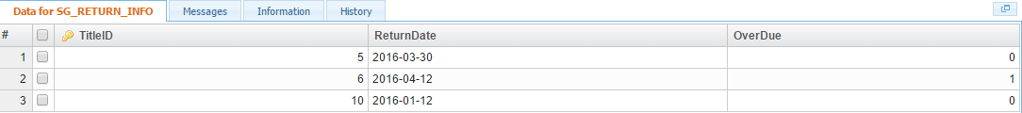

Slide 9
My Database

